Slide 1
To replace with my own drawing

Slide 2
CSS143 Computer Programming (II)

Slide 3
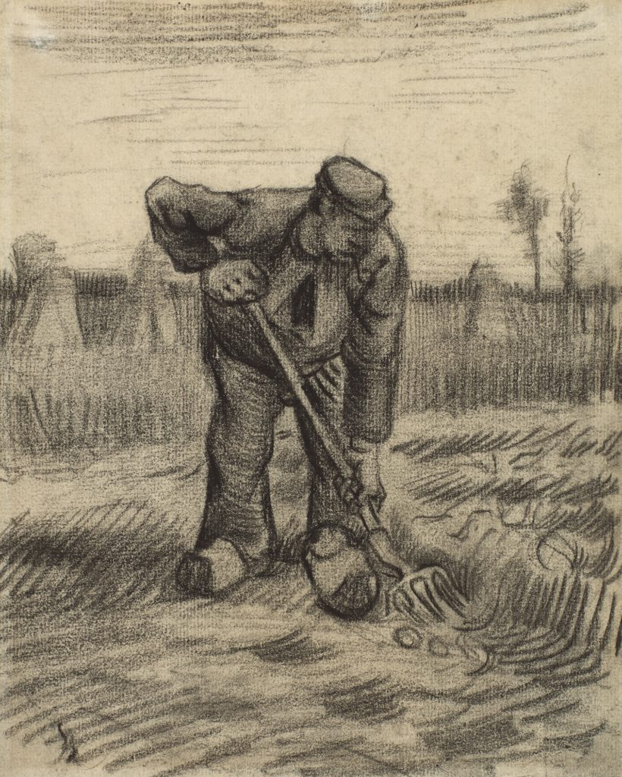
Logistics
Homework 1 grade by this weekend
Homework 2 due next Monday
Homework 3 due next Thursday
Midterm 1 next Wednesday
Open book
Example exam next Tuesday

Slide 4
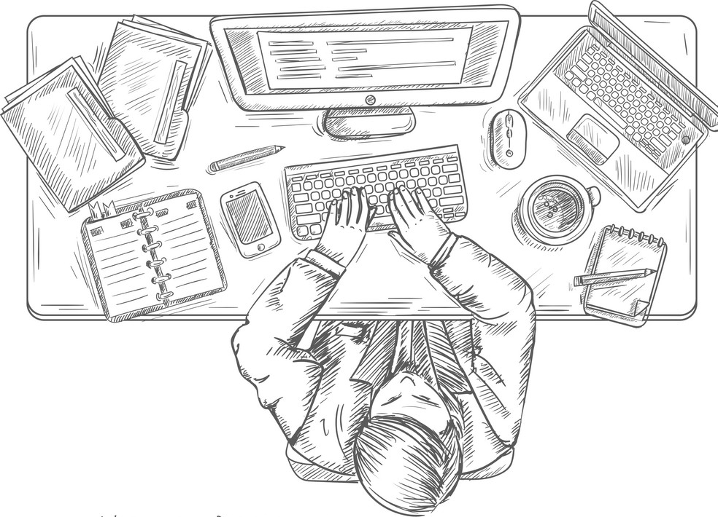
Homework 2 Preview
https://github.com/pdgetrf/CSS143B-2020Fall/tree/master/homework/homework_2

Slide 5
Homework 2 P1
Array of 0s, 1s, and 2s
Sort by all 0s on the left, all 2s on the right, all 1s in the middle
Input: [2, 0, 2, 1, 1, 0]
Output: [0, 0, 1, 1, 2, 2]
Make one and only one pass
No library or additional arrays
All tests provided. Do not change test file.

Slide 6
Homework 2 P2
Sorted integer array
Remove duplicates, each number appears only once
Input: [0, 0, 0, 1, 1, 2, 2, 3, 4, 5, 5]
Output: length 6
[0, 1, 2, 3, 4, 5, x, x, x, x, x]
No library or additional arrays

Slide 7
OOP Review Summary
Encapsulation
Class vs Object/Instance vs Reference
Default access
Private member vs public method (setter/getter)
Inheritance
Base class and derived class
Calling base class copy constructor
Override vs Overload
Polymorphism
Accessing derived class object using base class reference

Slide 8
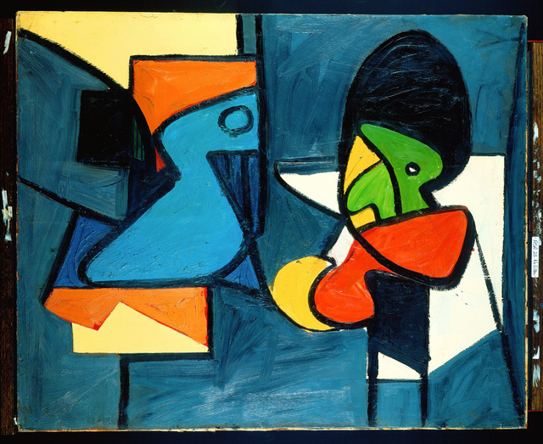
Abstract Data Structure
Arshile Gorky | Abstraction (1936)
List
Queue
Stack
Binary Tree
Hashtable
Interface
Implementation
Img: https://www.123rf.com/photo_52465854_stock-vector-passengers-in-queue-waiting-check-in-counters-at-airport.html

Slide 9
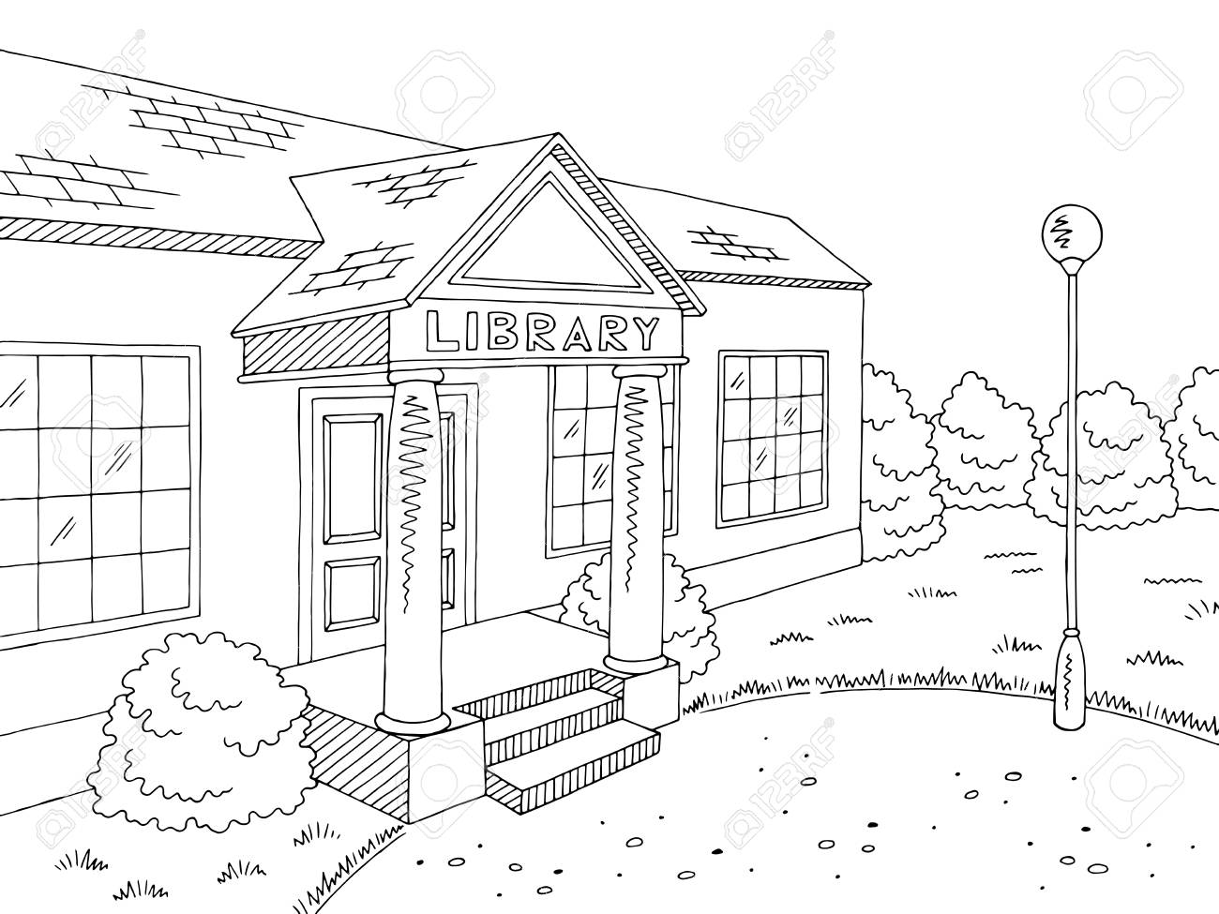



Queue As A Buffer
Subscription: 1 book per week through mail
Me: finish 1 book per MONTH

Slide 10
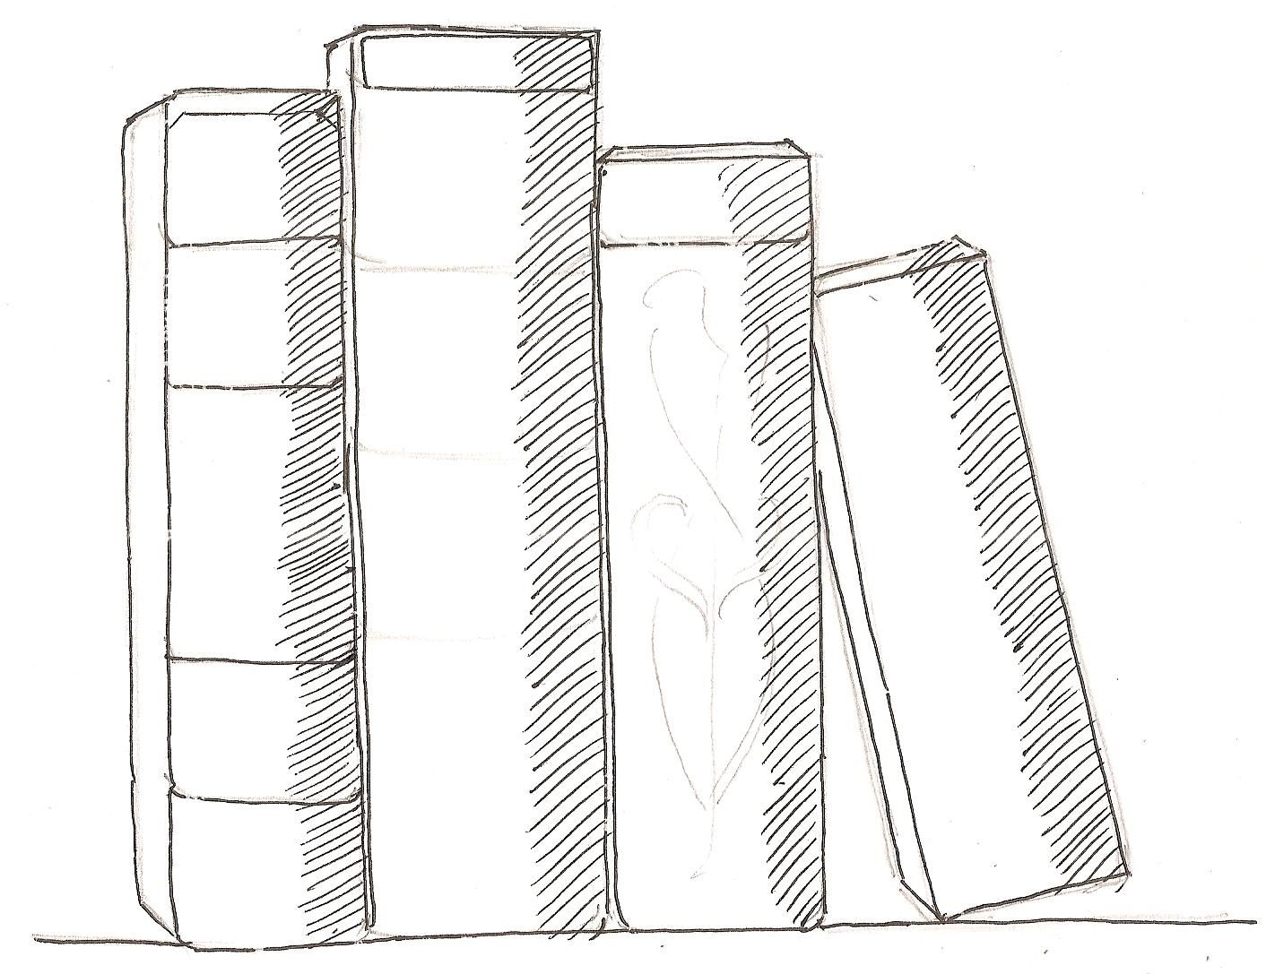
Queue As A Buffer
Subscription: 1 book per week through mail
Me: finish 1 book per MONTH

Slide 11
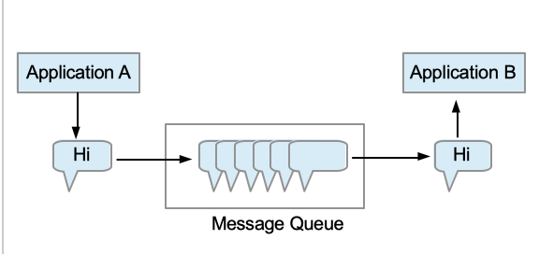
Message Queue
Goal: Allow different applications to work at different speed
Messaging queue (MQ) is used for asynchronous application to application communication.
https://medium.com/@Mohitdtumce/what-is-message-queue-b5468ff6db50

Slide 12
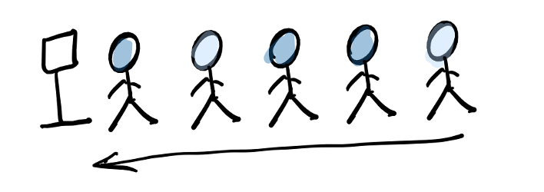
Abstract Data Structure
Design a class that represents a Queue
First in, first out (“first come, first serve”)
Usage: queueing scheduling system, message queue
Img: https://www.123rf.com/photo_52465854_stock-vector-passengers-in-queue-waiting-check-in-counters-at-airport.html

Slide 13
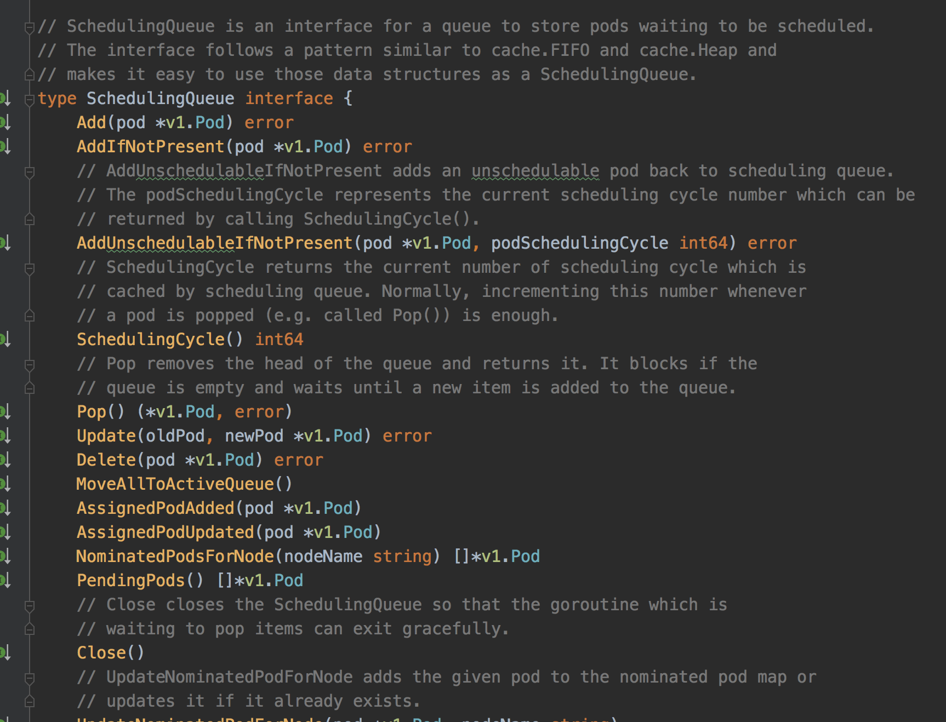
Queue example: Kubernetes Scheduler
pod
pod
pod
pod
pod
pod
pod
pod
Pod Queue
pod
pod
pod
pod
pod
pod
pod
pod
pod
pod
pod
Scheduler
https://github.com/kubernetes/kubernetes

Slide 14
Queue Example: In the Linux Network Stack
Driver queue.
The driver queue holds elements of the packet data
https://www.coverfire.com/articles/queueing-in-the-linux-network-stack/

Slide 15
Abstract Data Type (ADT)
Interface
Public functions
Implementation
- Internal details (not exposed to outside)

Slide 16
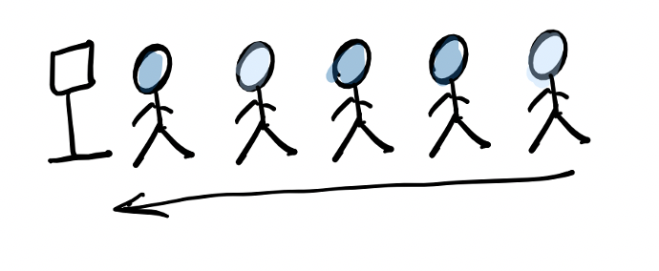
Queue Interface
What can you do with a queue?
Take someone from the front
Add someone to the end

Slide 17
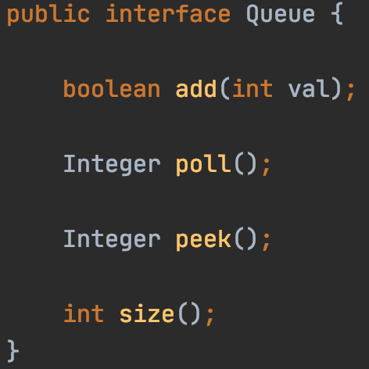
Queue Interface
What can you do with a queue?
Take someone from the front
Add someone to the end

Slide 18
Abstract Data Type (ADT)
Interface
Public functions
Implementation
- Internal details (not exposed to outside)
FIRST IN, FIRST OUT
How do we store the data?
Possibly many options.
Let’s go with array for now.

Slide 19
ADT Queue
Array Implement
poll() “get and delete”
“front”
1
2
3
4
5
“end”
add(int) “append”

Slide 20
ADT Queue
Array Implement
1
2
3
4
5
poll()
2
3
4
5
poll()
3
4
5
add(6)
3
4
5
6
add(7)
3
4
5
6
???

Slide 21
0
1
Can we use this spot?
3
5
6
2
3
4
5
6
???
5
4
0
1
2
3
4
5
4
3

Slide 22
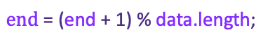
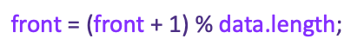
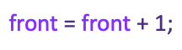
end idx = 0
0
1
$$\text{e}\text{nd}\text{ = (}\text{end}\text{ + 1) \% }\text{data}\text{.}\text{length}\text{;}$$
8
front idx = 2
end idx = 5
6
3
5
2
$$\text{front}\text{ = }\text{front}\text{ + 1}\text{;}$$
$$\text{front}\text{ = (}\text{front}\text{ + 1) \% }\text{data}\text{.}\text{length}\text{;}$$
5
4
front idx = 3
4
3

Slide 23
ADT Queue
Array Implement
1
2
3
4
5
poll()
2
3
4
5
poll()
3
4
5
add(6)
3
4
5
6
add(7)
7
3
4
5
6
add(8)
7
8
3
4
5
6
Full!

Slide 24
ADT Queue
Array Implement
add(6)
3
4
5
6
add(7)
7
3
4
5
6
add(8)
7
8
3
4
5
6
Full!
poll()
7
8
4
5
6
poll() x 4
8/8
poll()
empty

Slide 25
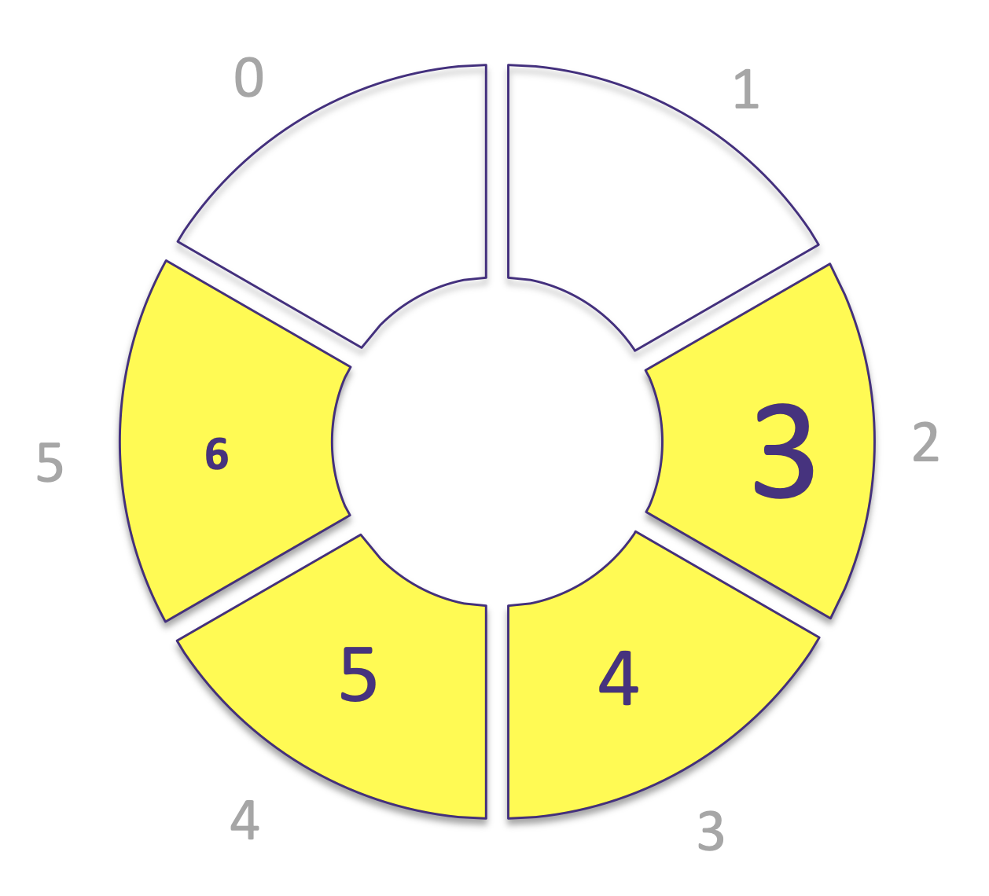
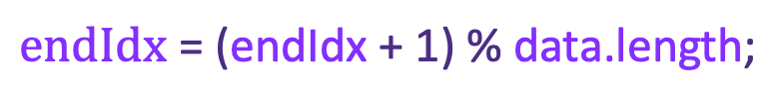
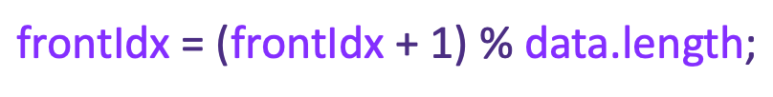
Circular Queue
When poll()
$$\text{front}\text{Idx}\text{ = (}\text{front}\text{Idx}\text{ + 1) \% }\text{data}\text{.}\text{length}\text{;}$$
When add(value)
$$\text{endIdx}\text{ = (}\text{endIdx}\text{ + 1) \% }\text{data}\text{.}\text{length}\text{;}$$

Slide 26

Get starter code from here:
https://github.com/pdgetrf/array_queue

Slide 27
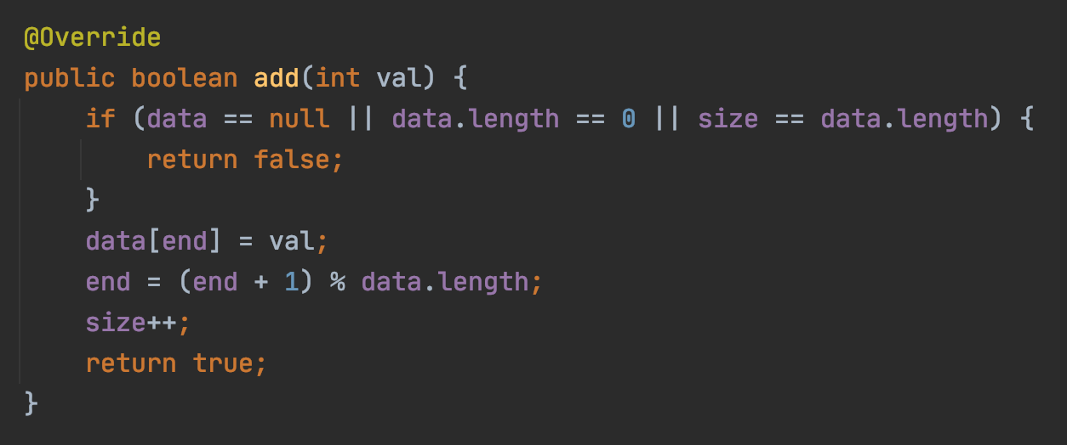
ADT Queue
Add one more
Add a value to a queue
mod operation
0 % 6 = 0
1 % 6 = 1
2 % 6 = 2
3 % 6 = 3
4 % 6 = 4
5 % 6 = 5
6 % 6 = 0
7 % 6 = 1
13 % 6 = ??

Slide 28
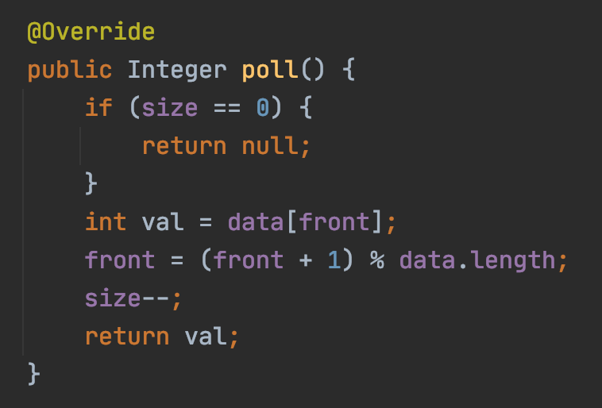
ADT Queue
Pick and remove
Get and remove a value from a queue

Slide 29
Abstract Data Type (ADT)
Interface
Public functions
Implementation
- Internal details

Slide 30
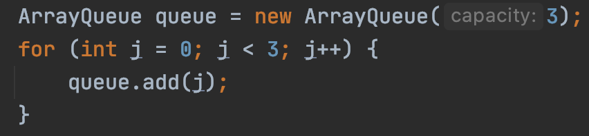
What if we need integer rather than int?

Slide 31
Java Generics
What if we also need a queue but for String?
What if we also need a queue but for float?
What if we also need a queue but for Boolean?

Slide 32
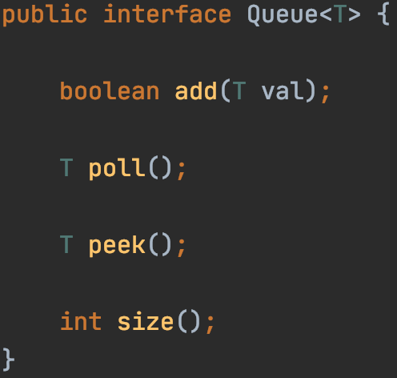
Java Generics

Slide 33
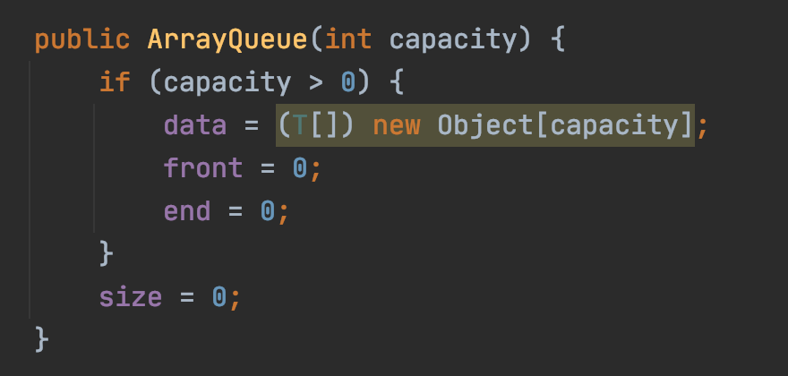
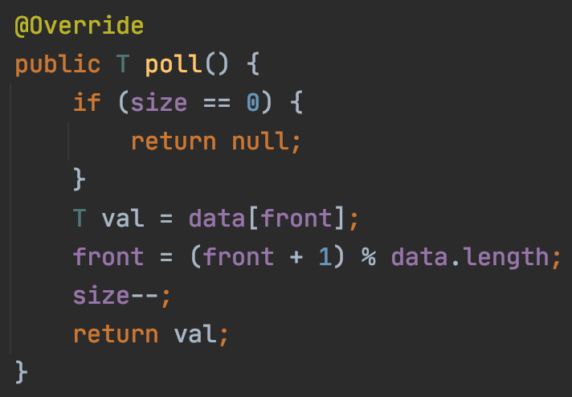
Java Generics
constructor

Slide 34

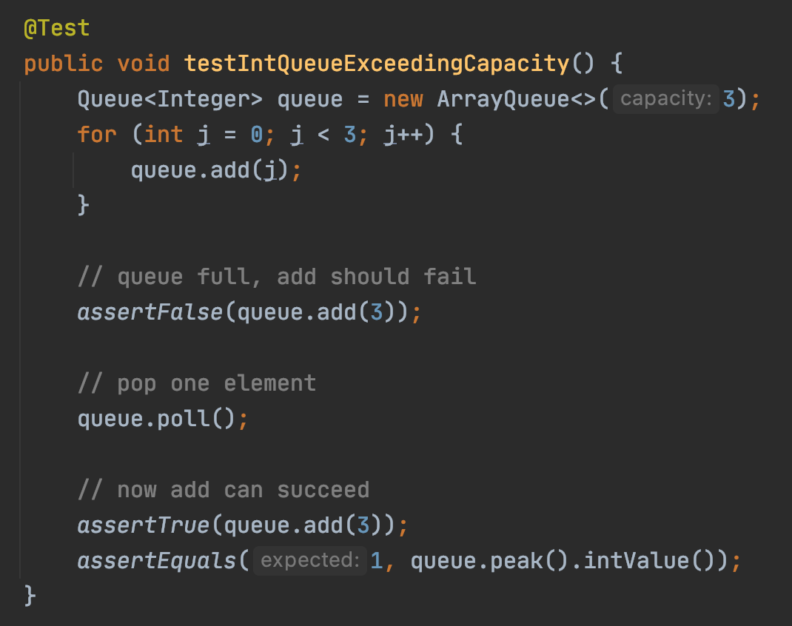
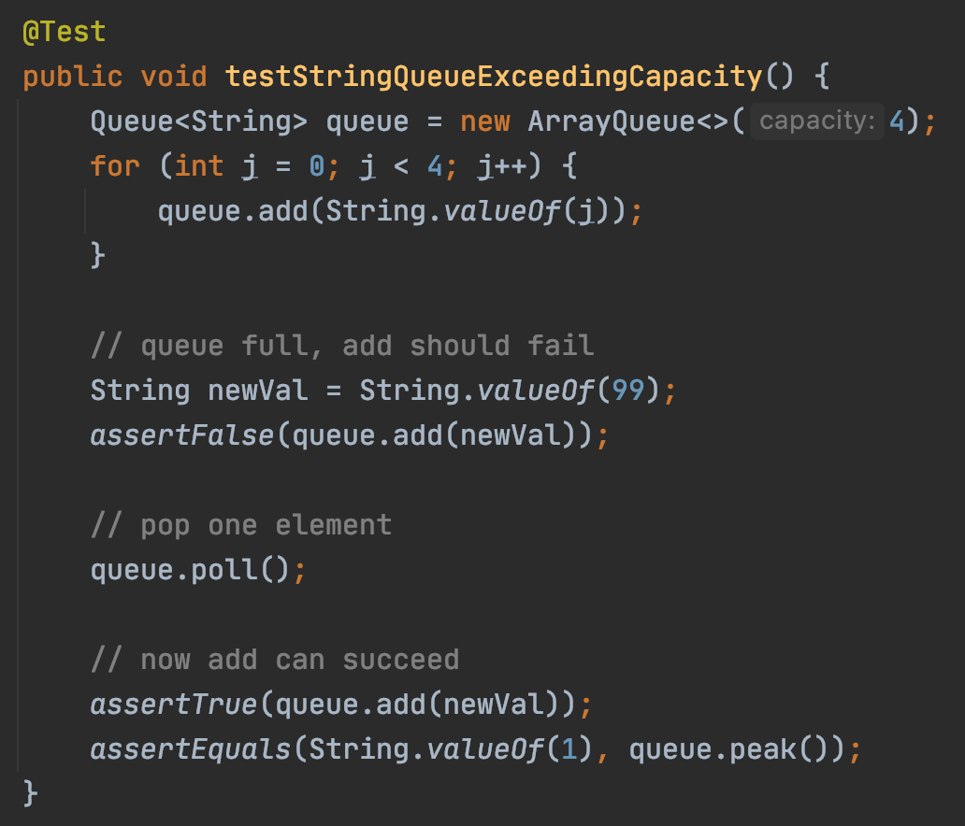
Java Generics

Slide 35
What if we need to increase capacity to 3+ elements?

Slide 36
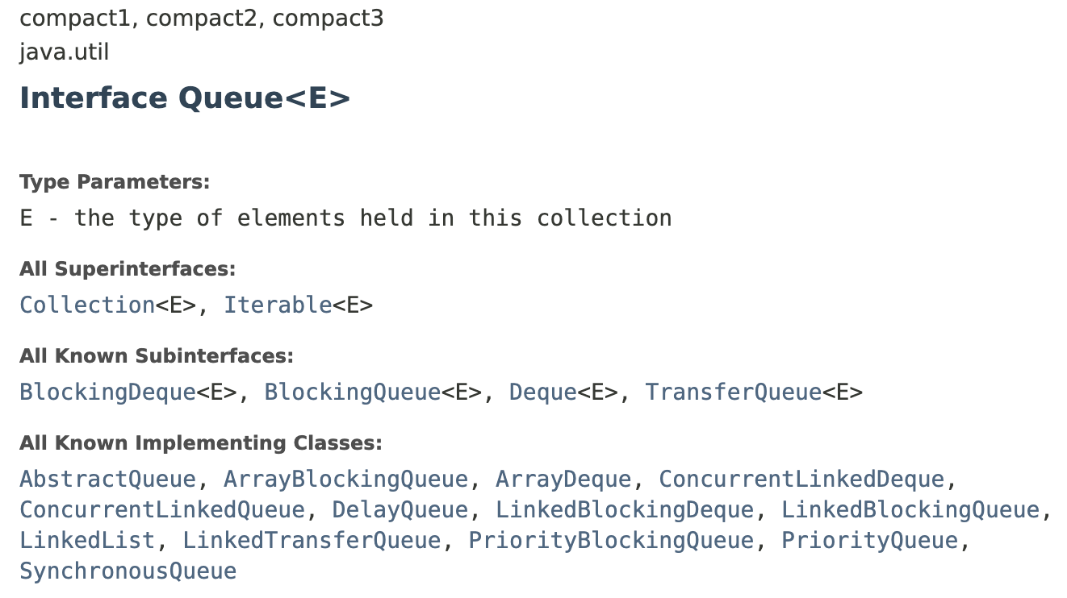
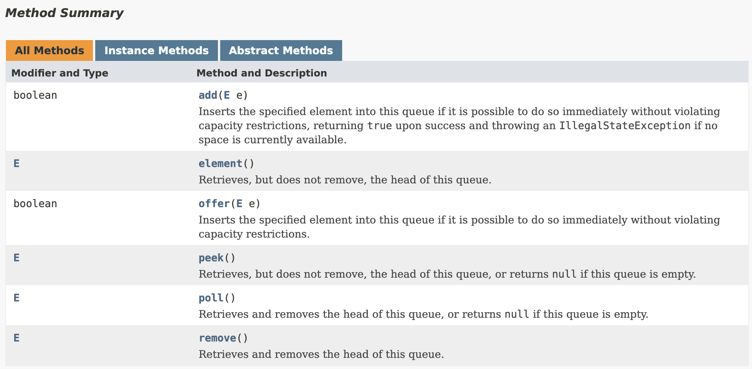
Java Queue Interface

Slide 37
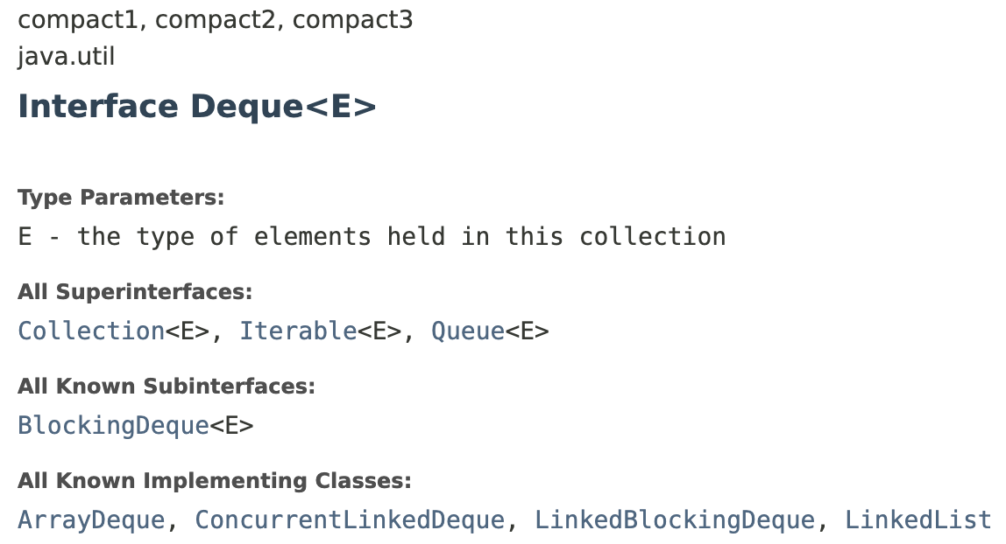
Java Queue Interface
A linear collection that supports element insertion and removal at both ends
The name deque is short for "double ended queue"

Slide 38
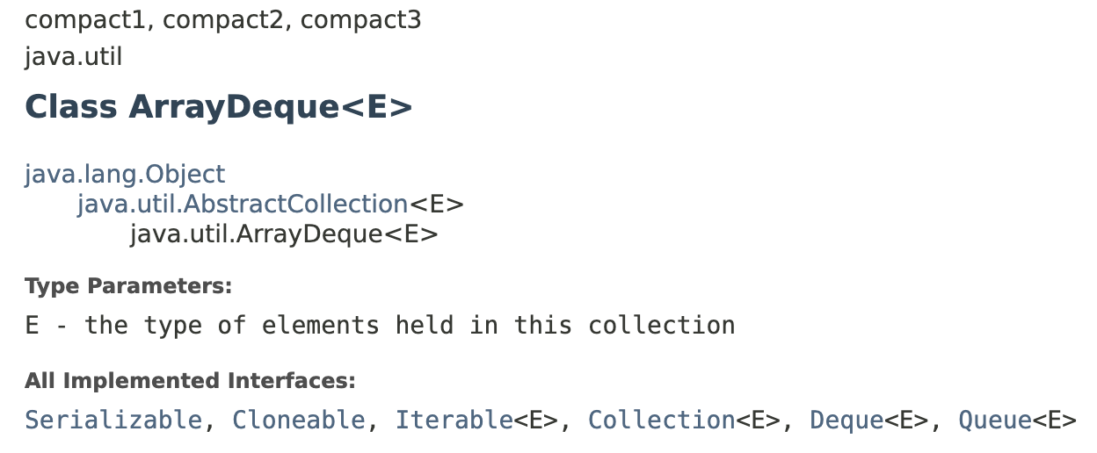
Java Queue
Inheritance

Slide 39
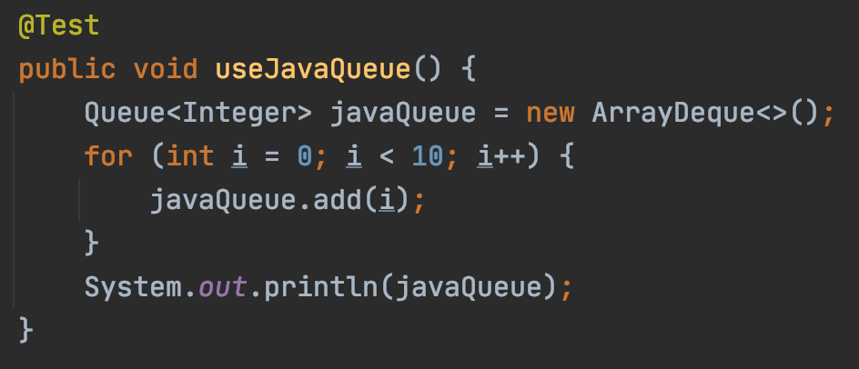
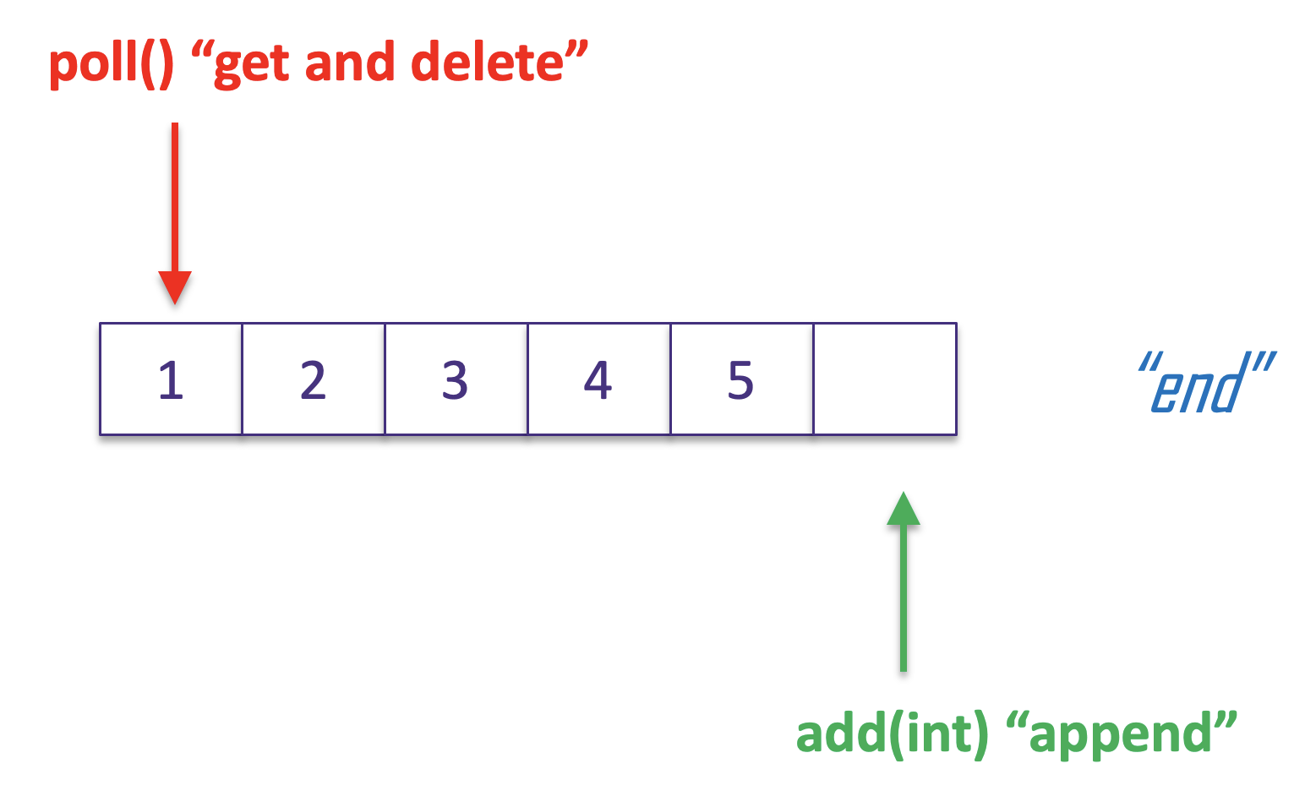

Java Queue
No size?

Slide 40
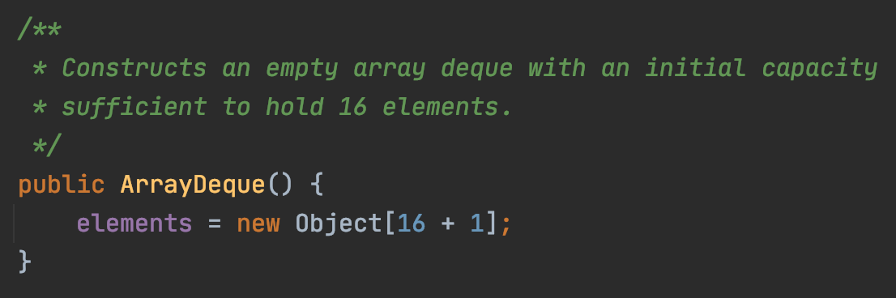
Java Queue
initial capacity

Slide 41
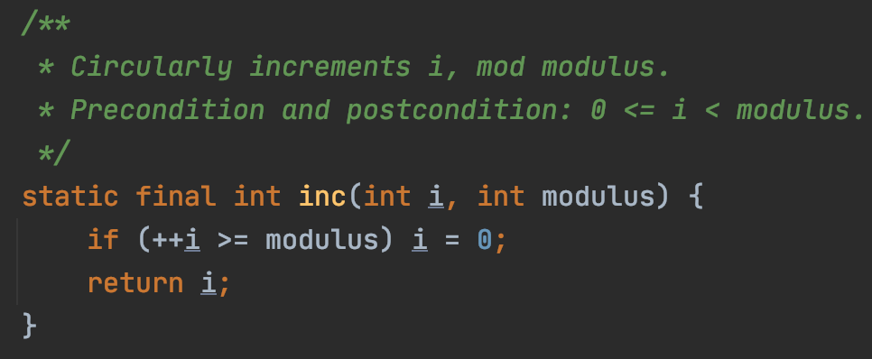
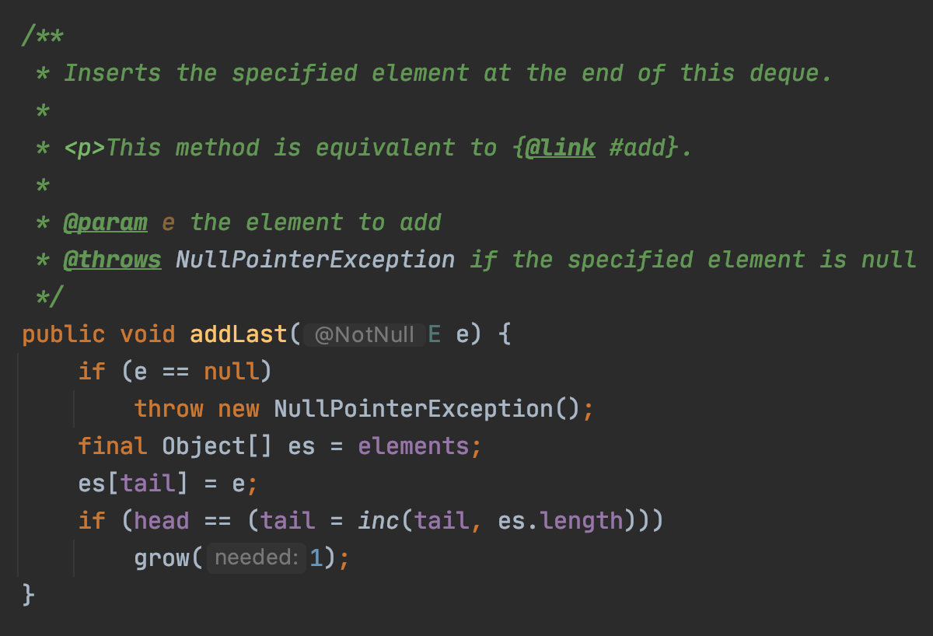
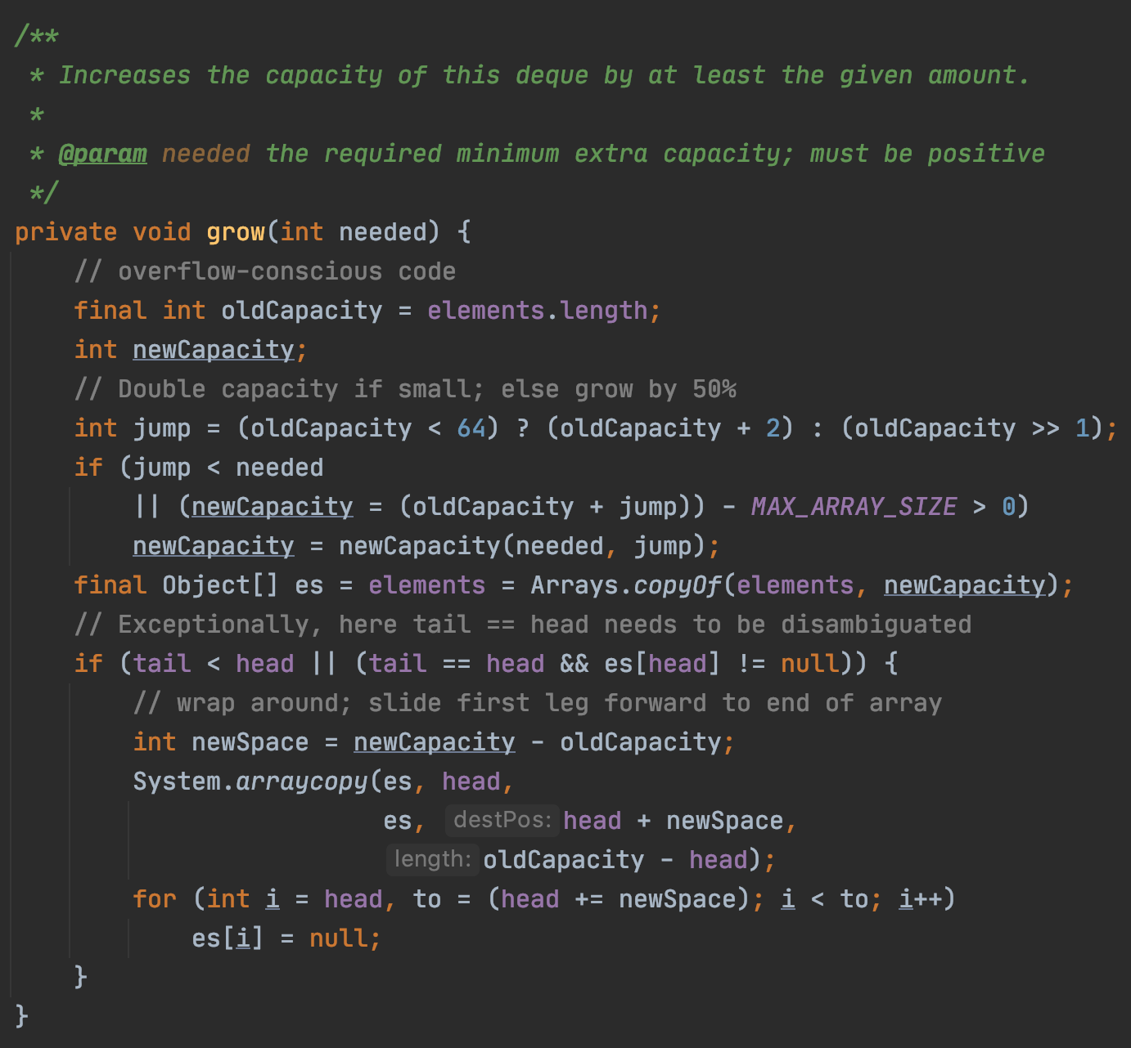
Java Queue

Slide 42
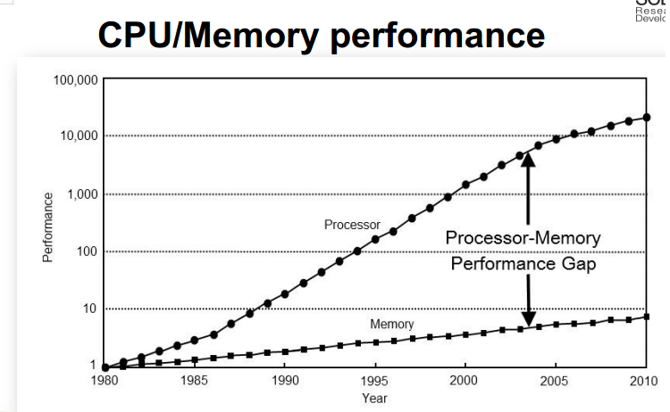
Java Array Queue
Capacity: Increase capacity by making copies
~~~~~~~~~~~~~~~~~~
Very slow!
how to improve?
Data types: Using generics

Slide 43
Complexity
poll() “get and delete”
“front”
2
3
4
5
“end”
add(int) “append”
Number of steps for each poll()?
O(1) - “order of 1”
Number of steps for each add(int)?

Slide 44
Abstract Data Type
Abstraction of a certain “logic” data type
Queue: First in, first out (FIFO)
Public access defined by interface
poll(), add(E value), …
Internal implementation
E[] with circular access
O(1) for both poll() and add(int)

Slide 45
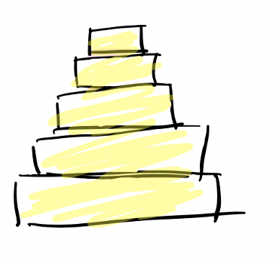

Exercise
Queue ADT: First In First Out
Stack ADT: Last In First Out (LIFO)
What function in the interface?
How to store data?
How to implement stack using array?

